Slide 1
E-Corp Discussion and Demo
HashiCorp
June 2019
Notes:
That’s the title – I promise you we’re gonna break that down!
But we got a lot to cover so let’s get going…

Slide 2



About Me
mike.augustine825@gmail.com
@MAugustine825
Mike Augustine
(Devops/Enterprise/“functioning” Architect/Engineer)
Sr. Architect/Technical Lead
Notes:
honored to be speaking here
working in technology for many years, several disciplines
learned about the DevOps movement in its early days
{jump to speaker page} – bighead
Drop rest
working in technology for many years, several disciplines
in and out of consulting
learned about the DevOps movement in its early days
{jump to speaker page} – bighead
including operations/infrastructure, development and various levels of technical management
, occasionally in government, with this being first direct exposure to Federal Government
always been responsible for or associated with development and infrastructure automation and enterprise/corporate tooling
and made a specific career path towards it, including returning to more hands-on technical roles where my skillset lies and feel more productive
You may feel you know me from this conference of course as my new nickname

Slide 3

Today’s Agenda
We will cover:
Basics of the “business side” – purpose and requirements
Dive into the architectural and technical solutions, particularly as they pertain to the HashiCorp suite
Show some pics and sample code!
Notes:
[5] walk through together what would go into a hypothetical project building out such a cloud platform.

Slide 4




Getting Started
Greenfield!
Progressive gov’t thinking & support
Meaningful mission
Awesome team & colleague support
Notes:
takeaway: federal government does innovation with right leadership and good contractors
Next slide team pic

Slide 5








Federal Requirements
Supports lift and shift + refactored systems
Secure boundaries, allowing each tenant its separate enclave
Provides and inherits necessary government security controls
Users access systems via government identity
Tool agnostic
Logs and monitors all activity
Automated networking and configuration as code
Provide connection to internal client network
Notes:
lift and shift – migrate first
Tool Agnostic - Stay Generic enough to swap components in and out – they already have favorites
Segregate tenants – if this thing is multi-tenant, nobody better see my stuff!
They’re coming from data centers and gov networks with all the baggage
What does the Federal Government need from a cloud solution?
A lot of services are actually provided for them and they still need them (or at least think they do)

Slide 6
What About that Long Title?
Notes:
I promised I would break it down for you
it defines more of our requirements

Slide 7
Provisioning a Multi-Tenant CSP Agnostic Cloud Platform for the Federal Government
Support bringing a variety of apps/infrastructure to the cloud
Support tenants coming with their own technical capabilities
Multiple environments (dev/test/prod) and multiples of each
Notes:
Including hybrid (dc and cloud), lift & shift, re-factor, and net new
Not a full PaaS solution – promote IaC/DevSecOps, not hide
You may
need to spin up and tear down versions of the app environments for performance testing or vendor POCs
A few servers, multi-tenant web farms, mission critical, top secret

Slide 8
Provisioning a Multi-Tenant CSP Agnostic Cloud Platform for the Federal Government
CSP agnostic – able to deploy same apps to multiple CSPs
Still define infrastructure to the specific provider
But… avoid tool/feature lock-in
Notes:
We all know what CSP stands for now
The debate over build specific to CSP or build without it is another talk or HH convo
Some DevOps products try to genericize the CSP components, but the terraform approach with the structure we’re talking about makes a lot of sense.

Slide 9
Provisioning a Multi-Tenant CSP Agnostic Cloud Platform for the Federal Government
Do the hard stuff once
Provisioning/configuration for whole environments from end to end
Established and reusable services, Security practices and patterns
Reuse and easy adoption
Notes:
Everyone’s doing the same hard things over and over to get to the cloud
Especially in the government and when you have many separate agencies even under larger umbrella organizations
Secure from day 1 - very hard!
You see’in a pattern on the reuse thing – that’s what our platform needs to support well

Slide 10
Provisioning a Multi-Tenant CSP Agnostic Cloud Platform for the Federal Government
GovCloud ☺ ☹
Processes, paperwork, security controls
Multiple existing required integration points and services
However, the Federal Government is being innovative and agile particularly in the quest for the cloud…
Notes:
Govcloud – CSPs separate and approved government hosting - blessing and curse
Pps – aren’t going away. I was more optimistic at first, but that bubble has been burst a few times (but improvements underway)
Integration points/Ent services – network, data centers, identity providers, time servers
little bit on gov datacenter and app modernization ultimately going to the cloud. Years and multiple changes in direction…
Going to be a little risky in what I’m presenting and bring you in to a government site that I go to on occasion.
an analogy referencing that the Federal government and other government entities are in a mode of modernization including agile and devsecops and cloud and this is the analogy of current state:

Slide 11
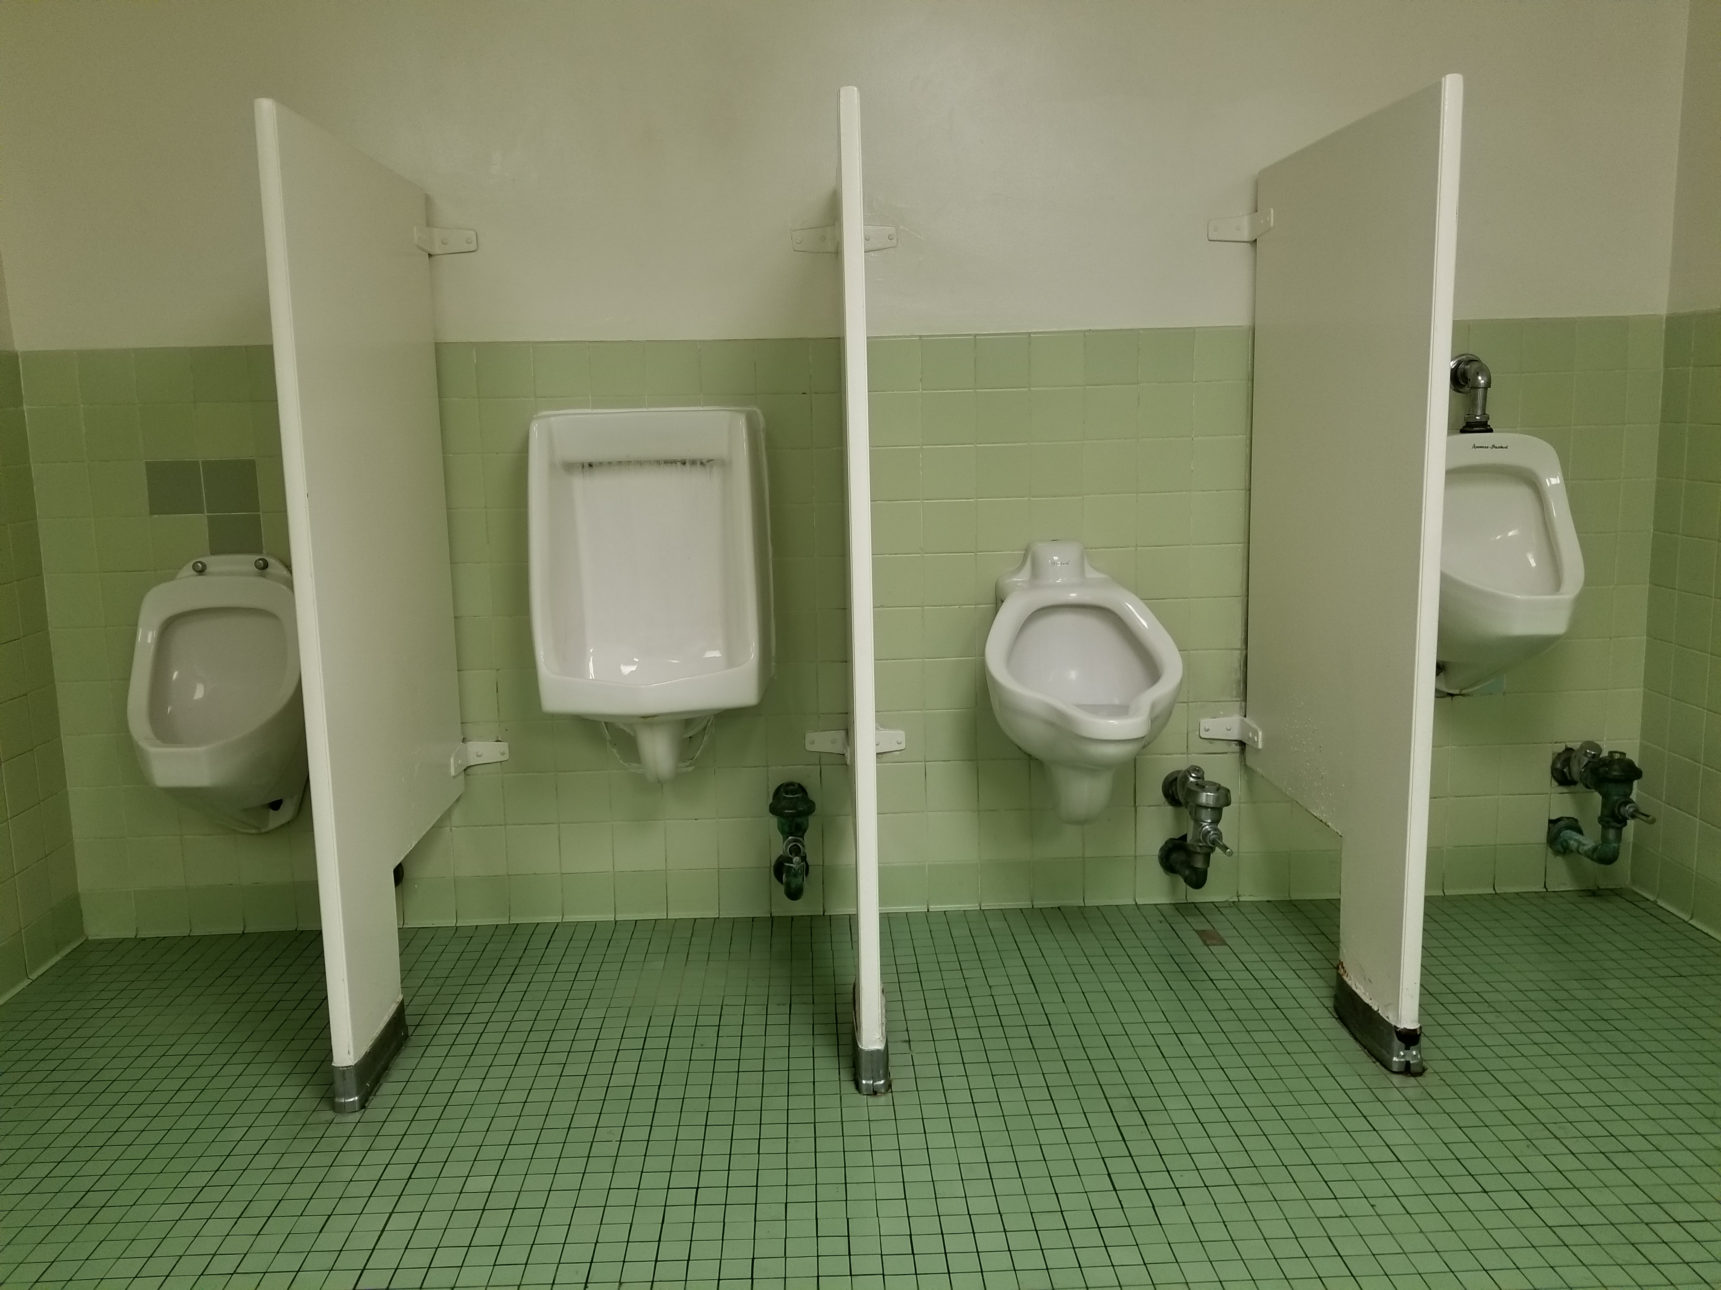
Notes:
As you see improvements have been attempted, often not going to full completion or deployment, new attempts started each with some level of success, yet still a ways to go.
And yes it really is that color green that we thought they abandoned in the 60s

Slide 12
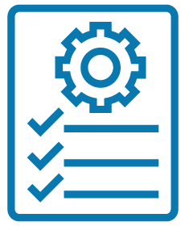
Architecture Requirements
Good tagging strategy
Security always
Reuse and easy adoption
Not a full PaaS solution
Own as much of your own destiny as possible
Notes:
[10] Not a full PaaS solution - promote/not hide IaC/CM/DevSecOps
Own your destiny: Example – use Vault as a trusted intermediate CA to the gov root and generate and replace your own certs on a much more rapid cycle

Slide 13
Enterprise Intranet
Cloud Intranet
Org A
Enterprise Networking
Transit
Tenant Org A
Org B
Tenant Org B
Shared Services and Management
Org C
Tenant Org C
Notes:
Lets take a look at what we’re talking about with this multi-tenant shared services platform.
Basic view of the world. There would be much more complicated technical diagrams, but for our purposes this gets to the point.
Note: cloud platform shared services should be built by cloud platform as early as possible
thing

Slide 14
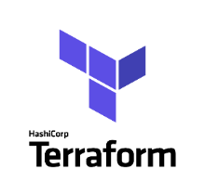
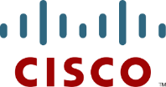
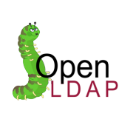




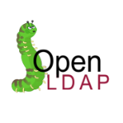
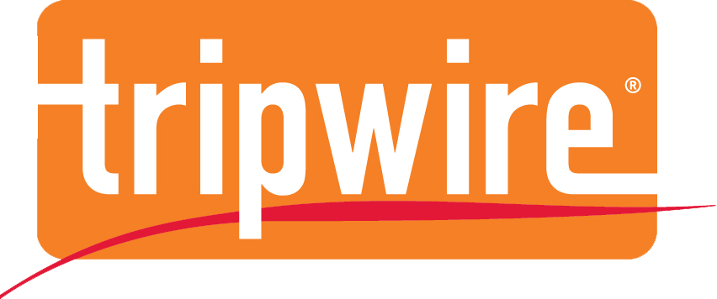

Shared Services and Management
Network
Services
Access Control Services
Automation
Services
Identity Mgmt.
Router
Provisioning
Supporting Services
Configuration Management
Tenant Product Instance
DNS
Router
Tenant Instances
Orchestration
Platform Mgmt.
Secrets / CA Management.
Dashboard & API
All instances get agents installed:
Service Discovery Backends
Vulnerability Scanning
Logger
Virus/MW
Repositories
Security Services
Source Code Repository
Vulnerability Scanning
Artifact Repository
Auditing
Container Mgmt.
Central Logging
Container Service
Auditing
Notes:
Let’s look at that ss&m offering
part of the dream devsecops engineer experience - implement a cool set of tools that will mesh together and drive everything going forward
in the multi-tenant space, not only supports all of the platform infrastructure and services, but it is available to the tenants to support their environments and applications.
The savings in time and money of a tenant app to be able to take advantage of these services day one is huge and compounded by each new lift.
one concern is the standard selection and procurement process in a government setting, particularly when trying to introduce new and innovative vendors and tools and concepts to a more static domain - could be years… NEXT

Slide 15
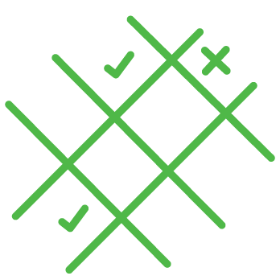
Tool Selection – Lean Evaluations
Define requirements
Research and select 3 products
Do quick install and eval
Review with product owner get decision
Results documented in an AOA, product approved for use in the TRM, and procurement initiated with a PO
Notes:
case of gov being open to streamline processes, way to make a lot of decisions and purchases in shorter time than usual
Where products are purposes and re-pluggable and making really bad decisions is mitigated, risk of a big mistake is low
Reqs such as:
had to support multi-tenancy to an acceptable degree including security and roles
Vendor support decent
Pricing withflexible growth strategies
Vendors have mixed feelings on the process. Can maybe win a POC but not a judgement call

Slide 16
Structures are Key
Set the base structures of how tenants will be defined and segregated early on and build it into everything
Set the code base structure early to support consistency, repeatable patterns, and dynamic expansion at the same time
Re-use Re-use Re-use! Code, structures, concepts, patterns
Notes:
It’s good to get in and start prototyping and experimenting and flushing out the architecture and design incrementally.
However, before you head too far down a path to your first mvp, there are things you will want to get figured out and have in place that will otherwise be difficult to retrofit later. Common terminology is part of this so the conversations make sense…

Slide 17
Tenant Categorization
Organization – HQ
Project - CloudPlatform Instance
(project abbreviation: cpinst)
Environment - dev
Product Instance - Dev02
Resource - cpinstdevDev02-vpc (resource type: VPC)
Notes:
This will be used throughout the platform to identify entities and segregate access to tenanat’s resources
Quick run through our usage tenant is a project comes from an org and product instance is one working environment

Slide 18
Tagging Strategy
tags {
Name = "cpinstMySQL01"
cpComponent = "HQ"
cpProject = "CloudPlatform Instance"
cpEnvironment = “dev“
cpProductInstance = “Dev02"
cpOwner = “CP Engineering"
cpExpiration = "0"
cpRunHours = "0700|1800"
cpVPC = "cpInstDev02-vpc"
}
Notes:
[needs renaming]

Slide 19
Naming convention
entity naming standard:
projectabbrev|environment|ProductInstance|-|PurposeName_classifer
example for a security group in this project tier:
cpinstdevDev02-MySql_client
Notes:
[needs renaming]
jokes about others saying what is with this

Slide 20
IaC Repos
SCM repositories separate product instance code bases
Logical view as well as security/access level separation
Separate Repo(s) for Core platform - reusable code/modules
Notes:
[15] Just introduce and then explain diagram

Slide 21
Cloud Platform CORE
Shared Modules (base OS instance, utils, tests)
Networking (VPCs, peers, subnets, routers, routing)
Connectors (security groups, service configurations)
Compute (instance purpose modules)
Networking Layer
(Network infrastructure definitions and tfvars)
Connectors Layer
(Common and Shared Services definitions and tfvars)
Compute Layer
(Application infrastructure definitions and tfvars)
Product Instance Layer
(Common product instance definitions and tfvars)
Notes:
Core – platform code, reuse of modules
Tenants – 4 repos – explain then code examples re-inforce
platform owned by devsecops org, network engineers can own tenant network repo etc

Slide 22
Cloud Platform CORE
Shared Modules (base OS instance, utils, tests)
Networking (VPCs, peers, subnets, routers, routing)
Connectors (security groups, service configurations)
Compute (instance purpose modules)
Networking Layer
(Network infrastructure definitions and tfvars)
Connectors Layer
(Common and Shared Services definitions and tfvars)
Compute Layer
(Application infrastructure definitions and tfvars)
Product Instance Layer
(Common product instance definitions and tfvars)
Notes:
{CODE BREAK} CloudPlatform-IaC-Core
provision-common/scripts: Setup, init_S3, Environment, Assemble, Plan, Apply

Slide 23
Get Into Some Code Already!
Notes:
{Code Break} – CloudPlatform-IaC-Core
Core structure high level
Show module to module – toolstation to cplinux to ansible to ansible
Code hierarchy/structure – need graphic slide, then real
Multi-tenant handling (tiers, repos, etc.)
Heavy use of modules
Provision/Configure
Tenant code utilizes common tenant specific modules and common core modules
Tenant level modules
Migration to core with comparisons to terraform module registry – similar and possibly complimentary

Slide 24
Networking Layer
Connectors Layer
Compute Layer
configure
modules
roles
provision-aws
local modules
provision code
provision-azure
local modules
provision code
Product Instance Layer
Notes:
{Code Break} VPINSTDEV02-Compute - Tenant Level Repos
Walk through product instance, then compute for teststation calling its own module, then toolstation calling up
Then get into security group creation in services and sg setting in toolstation
Need for all services available to be able to streamline services availability
Structure concept – using named service groups as endpoints, server/client [relationship diagram]
It all comes down to 1s & 0s

Slide 25
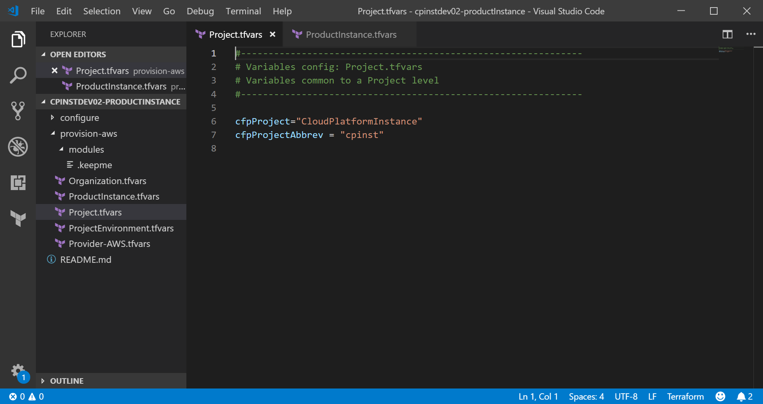
Notes:
{Code Break} – Tenant Product Instance
Tenant Product Instance variables set at categorization levels - quick

Slide 26
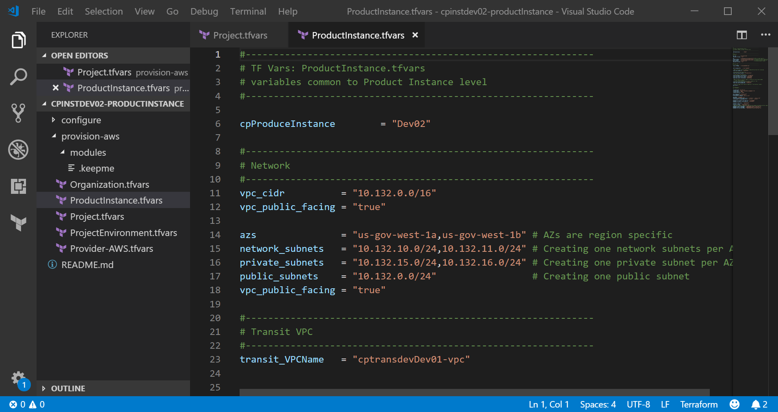
Notes:
{Code Break} – Tenant Product Instance
Tenant Product Instance variables set at categorization levels

Slide 27
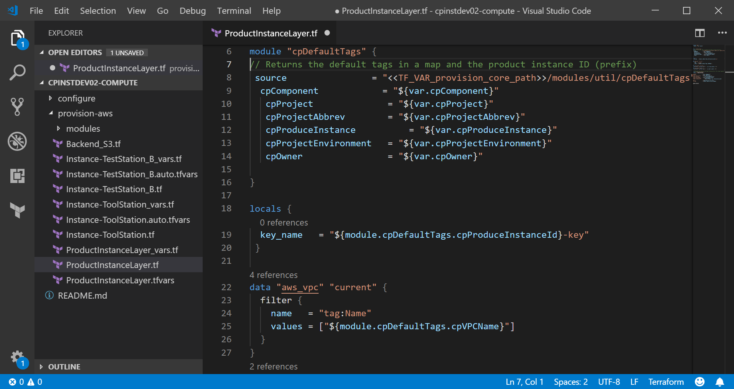
Notes:
{Code Break} – Tenant Product Instance
Code that sets up shared vars for all machines

Slide 28
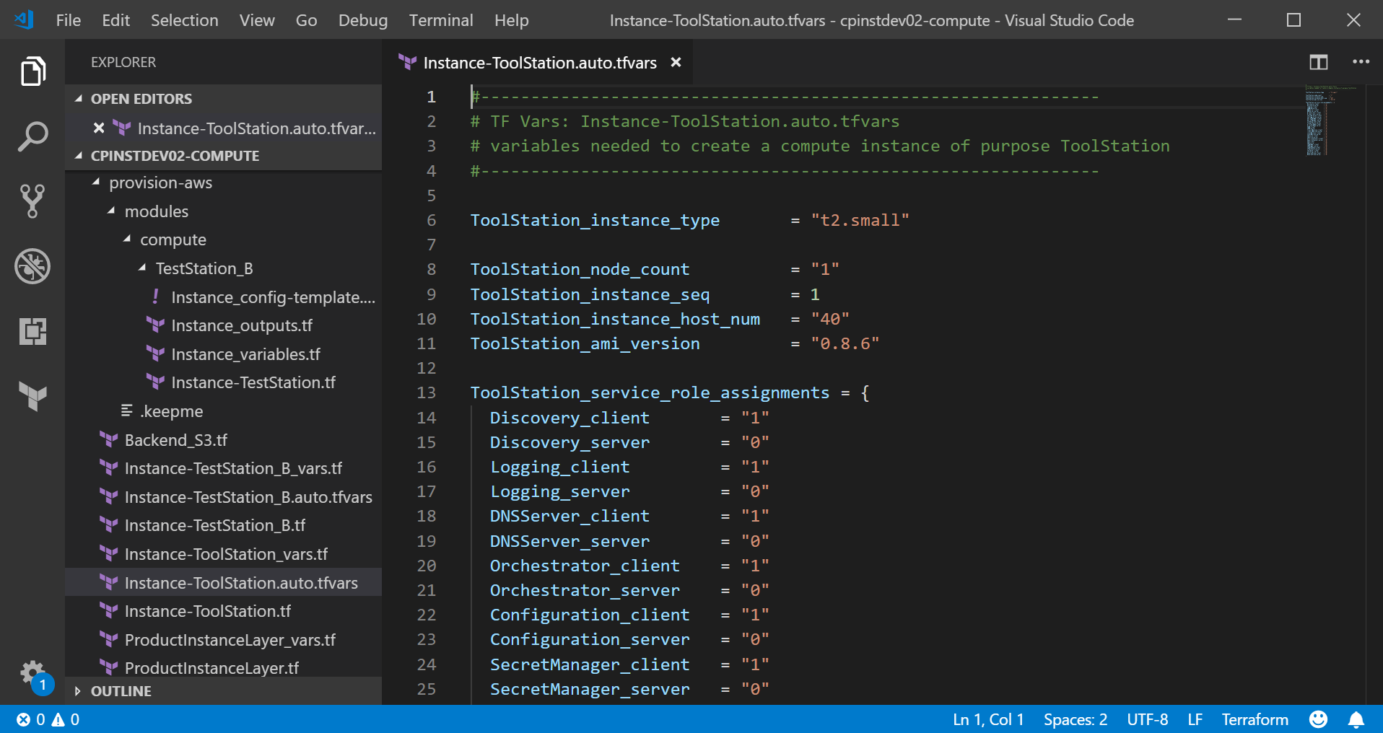
Notes:
{Code Break} – Tenant Product Instance
Toolstation tfvars
Discuss 1s&0s

Slide 29
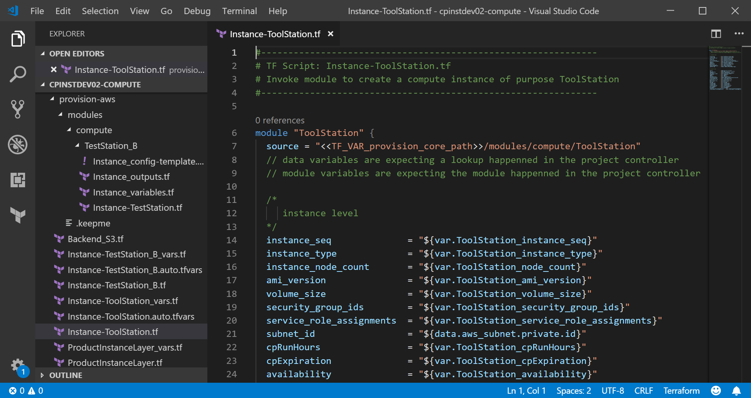
Notes:
{Code Break} – Tenant Product Instance
ToolStation calls common module

Slide 30
Cloud Platform CORE
build-aws
packer code
configuration management (ansible playbooks)
build-azure
packer code
configuration management (ansible playbooks)
configure
modules (ansible playbooks)
roles
provision-aws
shared modules
compute
provision-azure
shared modules
compute
provision-common

Slide 31
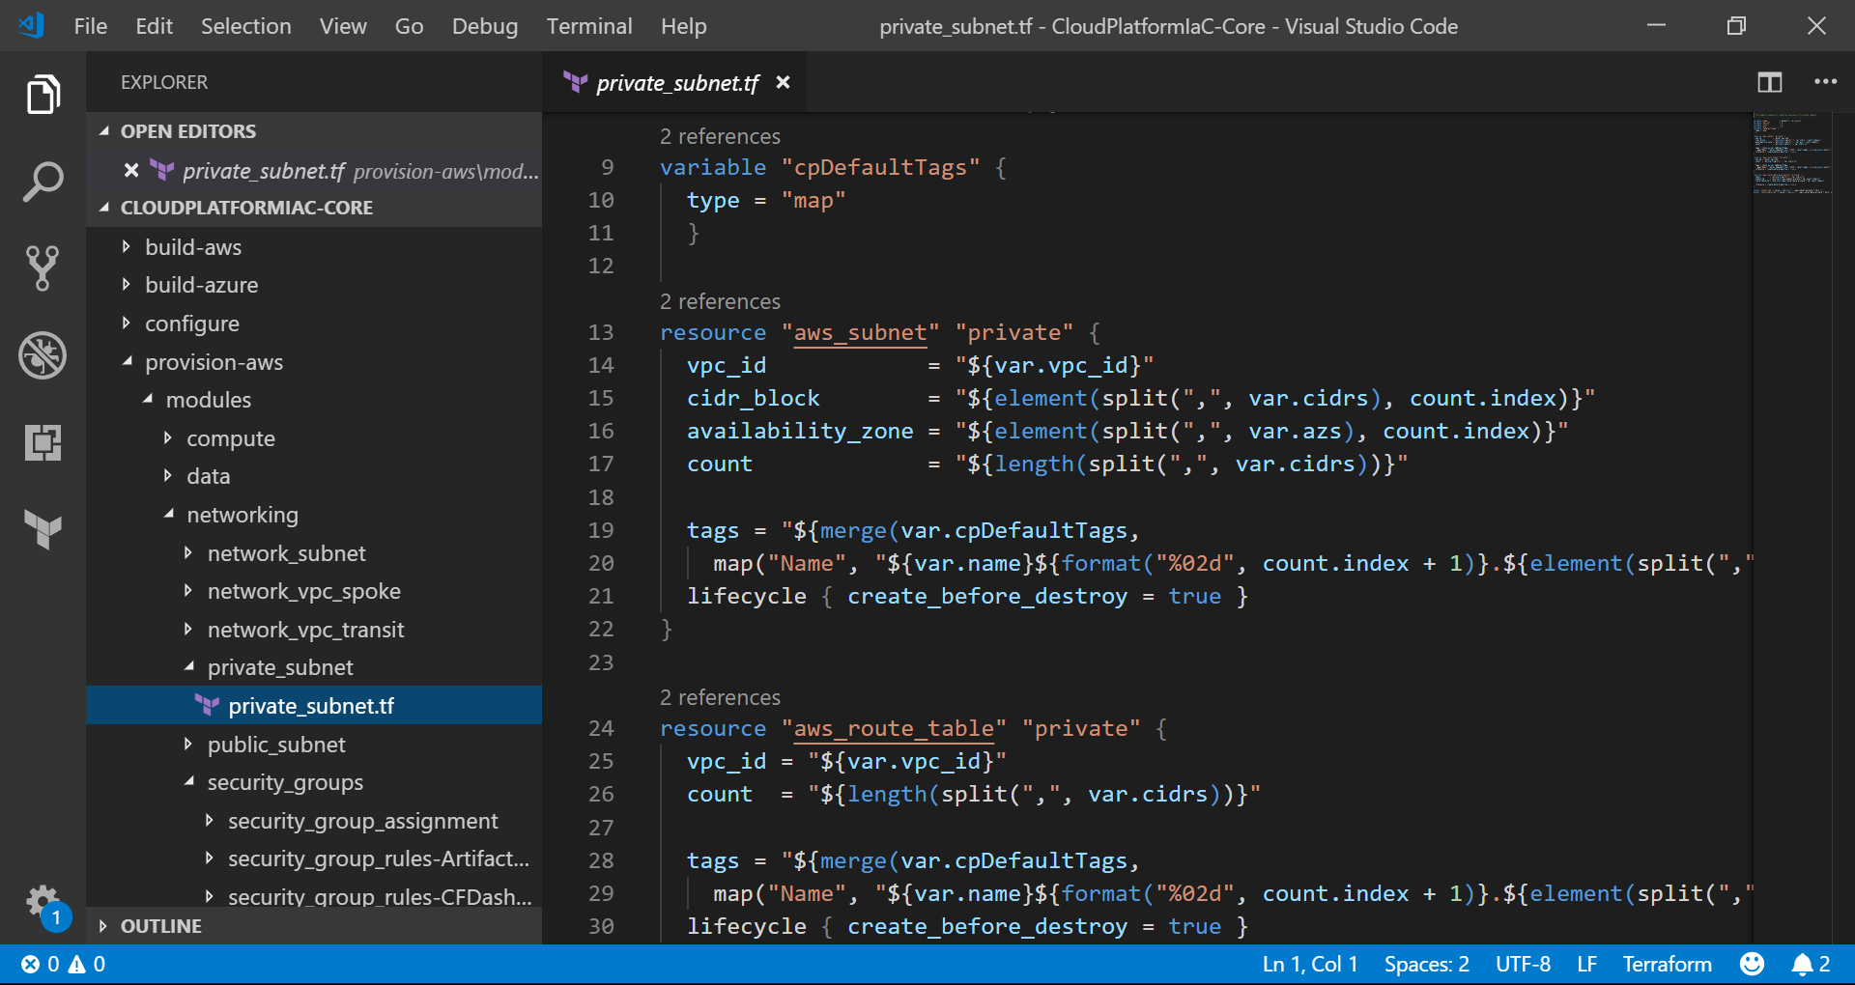
Notes:
{Code Break} – CloudPlatform-IaC-Core
Networking Layer components

Slide 32
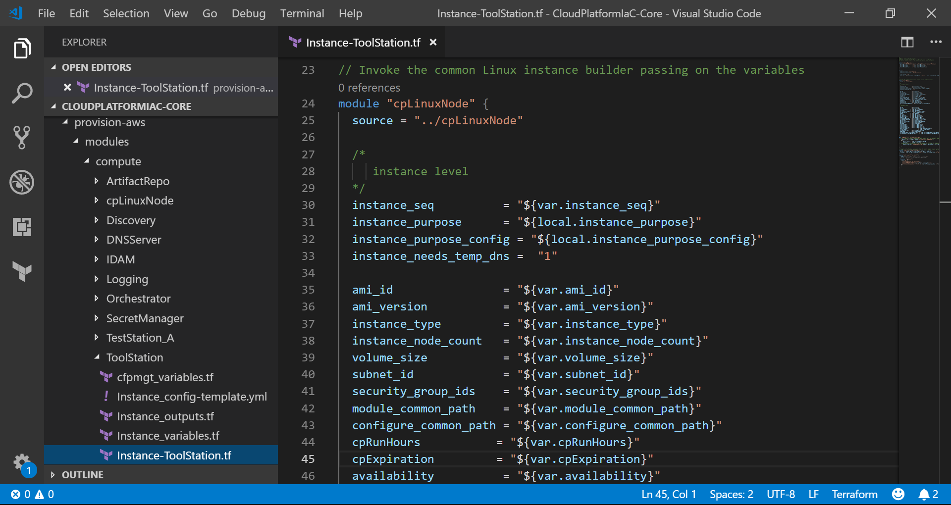
Notes:
{Code Break} – CloudPlatform-IaC-Core
ToolStation Module invoking linux node where ansible

Slide 33
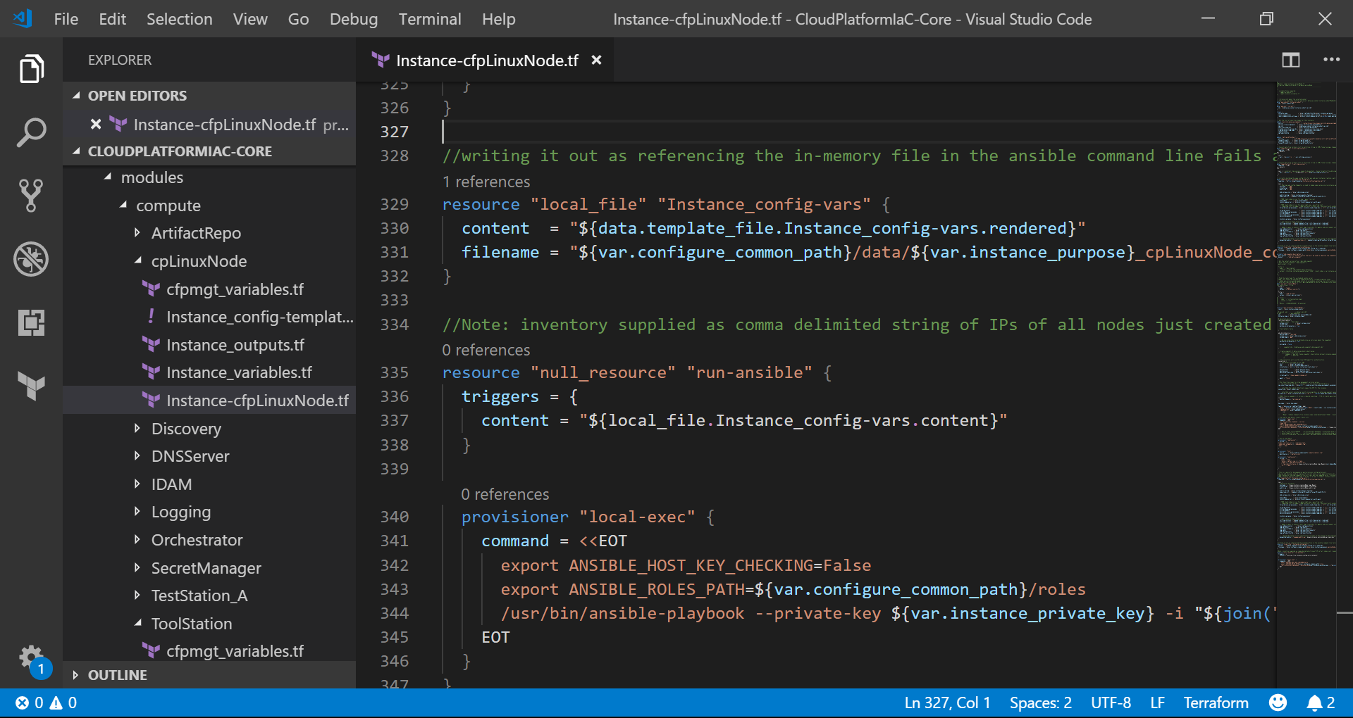
Notes:
{Code Break} – CloudPlatform-IaC-Core
Core structure high level
Show module to module – toolstation to cplinux to ansible to ansible
Code hierarchy/structure – need graphic slide, then real
Multi-tenant handling (tiers, repos, etc.)
Heavy use of modules
Provision/Configure
Tenant code utilizes common tenant specific modules and common core modules
Tenant level modules
Migration to core with comparisons to terraform module registry – similar and possibly complimentary

Slide 34
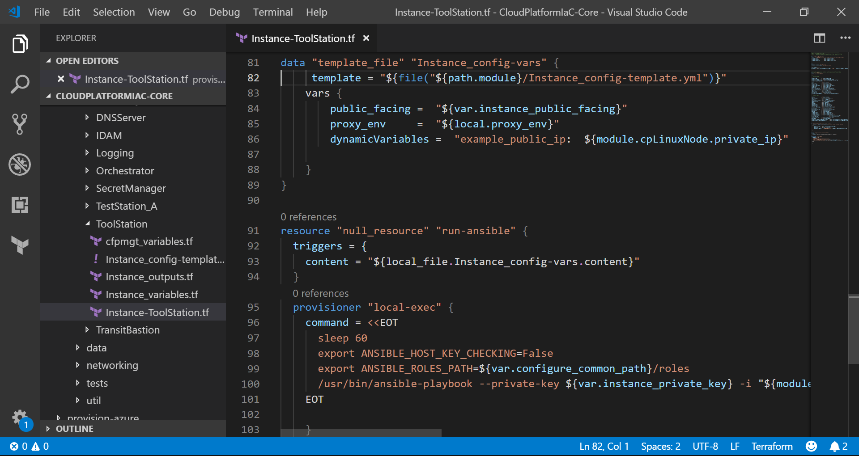
Notes:
{Code Break} – CloudPlatform-IaC-Core
Templated ansible vars
Run purpose code

Slide 35
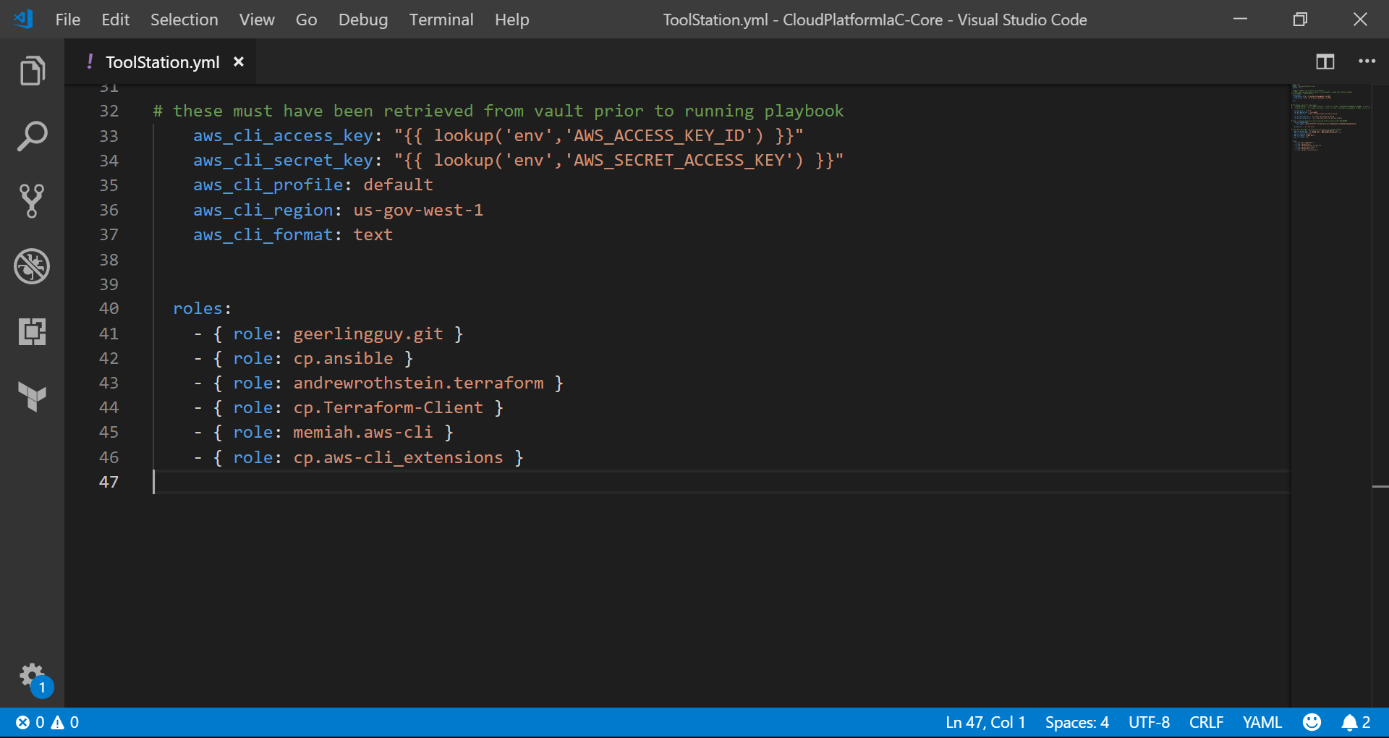
Notes:
{Code Break} – CloudPlatform-IaC-Core
Ansible playbook for Toolstation that applies several roles to machine

Slide 36
Provision Tenant Product Instance
Build sequence steps through setup and terraform stages for each layer:
Prep – set up the environment and set related environment variables
Build – pull down the repos, point to TF back-ends for workspaces
Plan/Destroy – standard TF stage
Apply – standard TF stage
Notes:
[20] Worksapces (State) has to follow structure – separate state for each project instance layer
{Code Break} code – build scripts

Slide 37
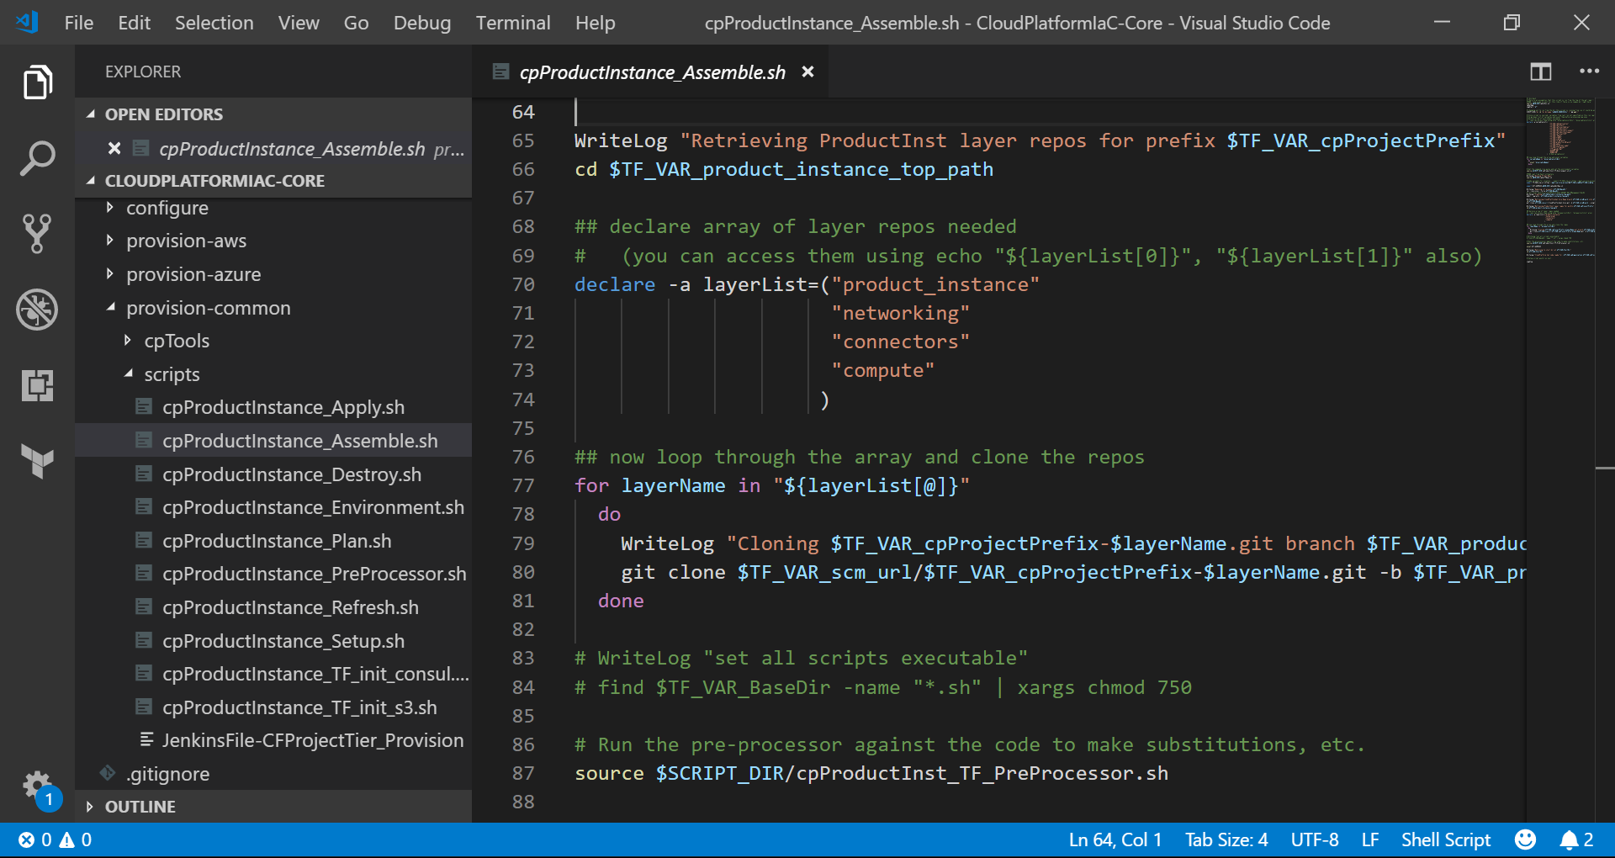
Notes:
{Code Break} – CloudPlatform-IaC-Core
Build script (just showing one)

Slide 38
Transit
Org A Hub VRF
Org A
SCI
VPC
Tunnel
Shared Services and Management
VPC
Notes:
Here’s the cloud platform network and SS&M
Some kind of interconnect with gov/enterprise network
created and maintained with the same “eat your own dogfood” as any product instances.
And now the tenant needs a new development product instance…
Another basic view drilling down a bit into the networking aspects.
transit network may have special requirements to connect back home like using Cisco routers
It is the hub for both internal network to cloud platform as well as the inter-services and inter-tenant spaces connecting through secure and isolated networks.

Slide 39
Transit
Org A VPC
Org A Hub VRF
Org A
SCI
VPC
Tunnel
Shared Services and Management
VPC
Notes:
The networking layer build kicks off and the building blocks start falling into place
With a VPC

Slide 40
Transit
Org A VPC
subnet network
subnet az1
subnet az2
Org A Hub VRF
Org A
SCI
VPC
Tunnel
Shared Services and Management
VPC
Notes:
Additional network topology and resources are added

Slide 41
Transit
Org A VPC
subnet network
subnet az1
subnet az2
Org A Hub VRF
Org A Spoke VRF
Tunnel
Org A
SCI
VPC
Tunnel
Shared Services and Management
VPC
Notes:
plumbing to the transit network including perhaps another router appliance appear.
creating other network resources - peers, specific routing, gateways, etc.

Slide 42
Transit
Org A VPC
subnet network
subnet az1
subnet az2
Org A Hub VRF
Org A Spoke VRF
Tunnel
Org A
SCI
VPC
Service Connections
Tunnel
Shared Services and Management
VPC
Notes:
connectors layer kicks off
and defines the connectivity including security mechanisms to access the SS&M and internal networks

Slide 43
Transit
Org A VPC
subnet network
subnet az1
subnet az2
Org A Hub VRF
Org A Spoke VRF
Tunnel
VM 1
VM 2
VM 1B
Org A
SCI
VPC
Service Connections
Tunnel
Shared Services and Management
VPC
Notes:
Now everything’s ready to build the compute layer
and lay out the virtual instances and any other compute resources needed to deploy the application components.
{Destroy Next}

Slide 44
Transit
Org A Hub VRF
Org A
SCI
Tunnel
Shared Services and Management
Notes:
And what, the tenant no longer needs this test product instance…
with a few destroy sequences in reverse order – it’s all gone

Slide 45
Instance Creation and Configuration
Linux image/CM in instance build
vs
container approach of CM on AMI image
Immutable instance vs patching
Notes:
[30] Share how you can easily move to that
containers have a place, sorry still not heavy use in gov or for services (another talk/debate)

Slide 46

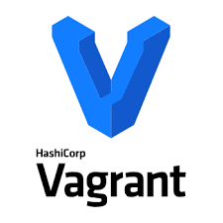


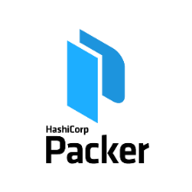



Source Code Repository
OS ISO
Supporting
Tools
Image Creation
Provisioning Tools
Artifact Repository
Servers & Services
Hardened OS Image
Instances
Notes:
Explain flow emphasizing Hashi products (Jenkins could be Nomad)
{CODE BREAK} Core - Hardening Scripts

Slide 47
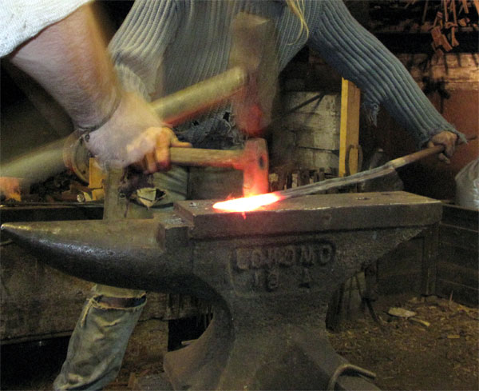
Image Hardening
Hardening – is hard!
meet CIS standards, Gov standards, and Security Scan requirements
Nessus and similar products don’t always know how to test for compliance – quite often semantically as opposed to testing outcomes.
Notes:
{CODE BREAK} CloudPlatform-IaC-Core
Configure creativeworks.cis_redhat tasks main, 1 include

Slide 48
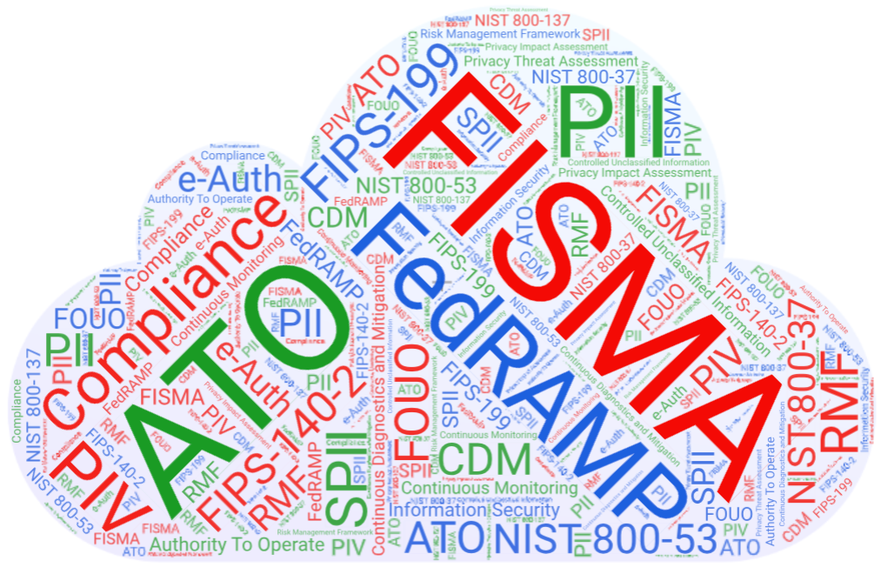
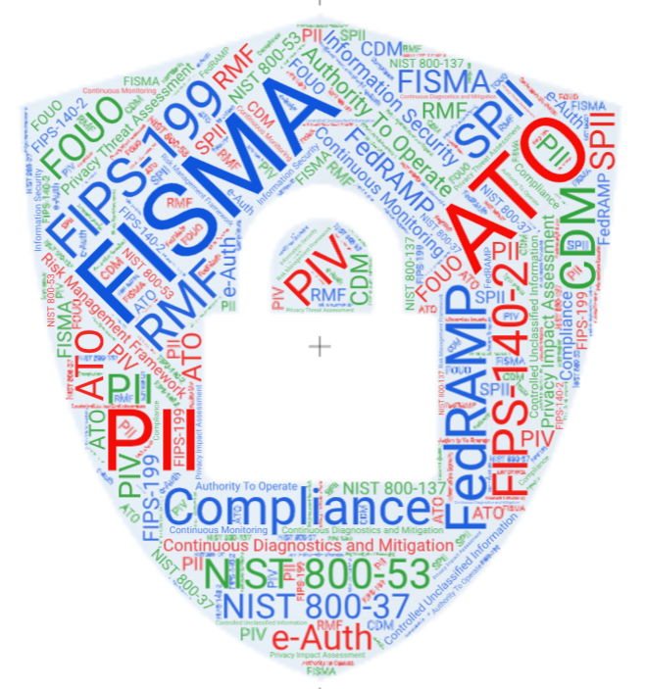
Federal Security
?
It’s Complicated
Notes:
Now we have to get our platform launched and start onboarding tenants. Oh wait, we’re going to need to be authorized to do that.
gets back to the acronym alert big time!

Slide 49

Federal Security Authorization Process
ATO (Authority to Operate)
Important ! But overly complicated and difficult !
Efforts underway to modernize
Prime example where DevSecOps with automation and provable immutability with tools like the HashiCorp suite can greatly assist modernizing
Notes:
Define ATO and say some nice words.
Fortunately, we have been baking the sec into devsecops from day 1!
More difficult than it needs to be!
Current time required won’t support volume of cloud migration
Efforts underway to make it: Repeatable (particularly for cyclical re-certs)
Applicable to modern technologies (i.e. cloud/immutable infrastructure)
Inheritance from CSP and then platform is a major benefit

Slide 50

Notes:
For now, common occurrence while participating in the Federal Security Authorization Process!
We’ve all been there…

Slide 51
Wrapping it Up…
Notes:
[35] We are authorized, finished, and launching our first tenants and bringing this to a close!
We’ve gotten through a lot of material on why, what, and how we might achieve the goals and realize the benefits of our multi-tenant CSP agnostic cloud platform for the federal government.
To demonstrate, I am going to step out again and allow you to come in to another government facility where the modernization efforts have been more recent and more successful…

Slide 52
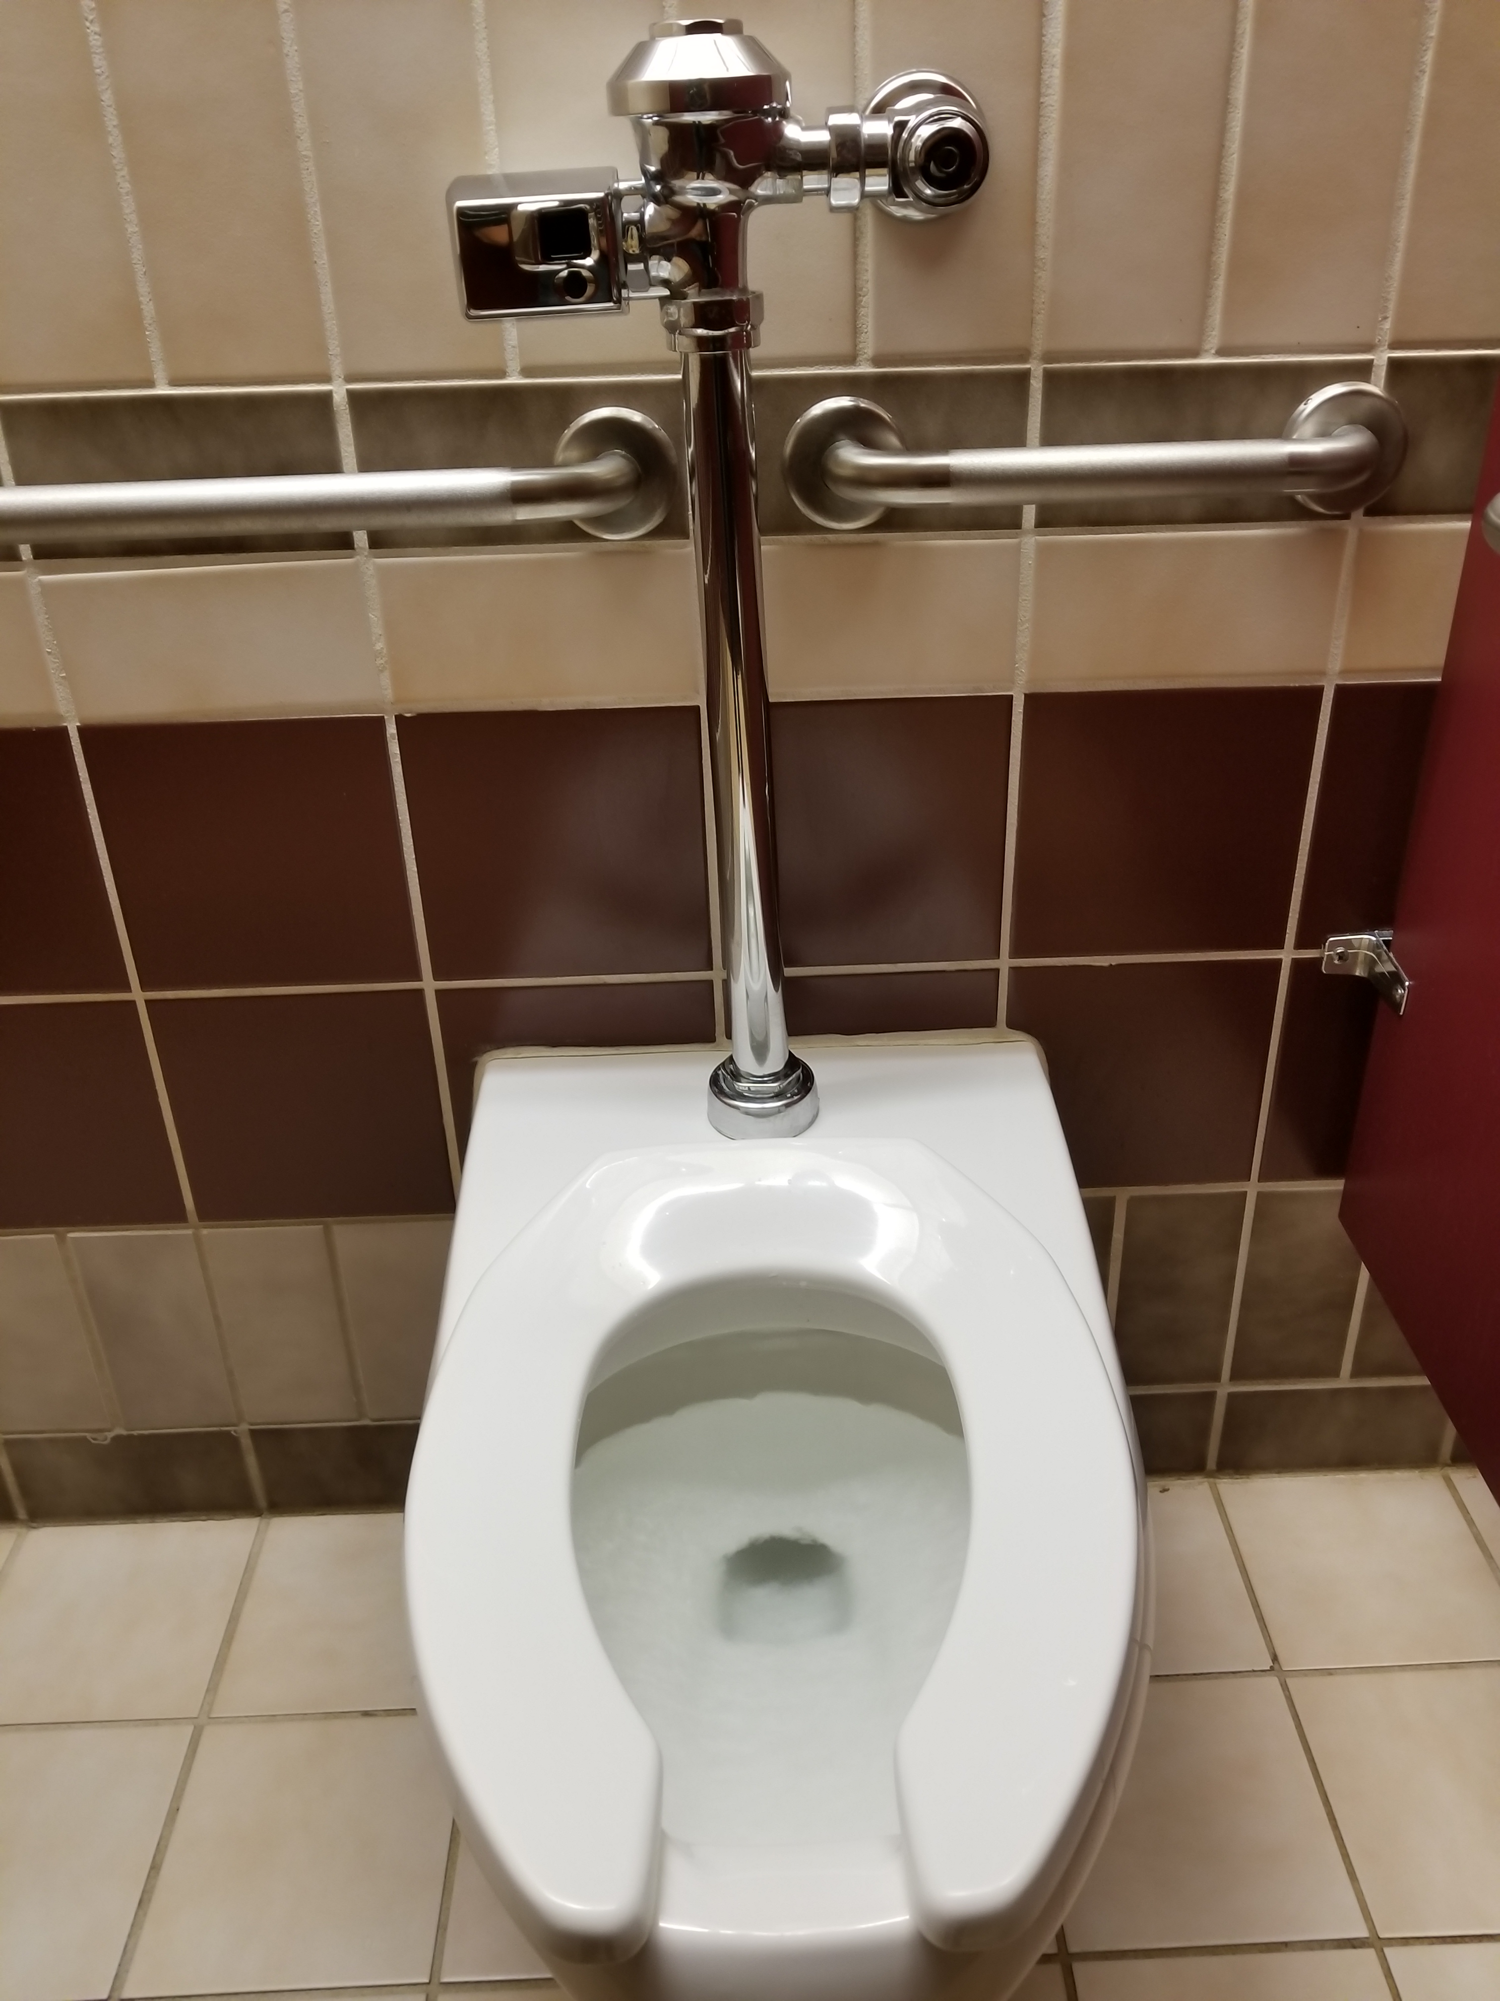
Notes:
Once again as an analogy, this represents the new app in the cloud. All modern and shiny and automated and acceptance and adoption rates are exceeding expectations.
But, of course it can’t be perfect and there will be ongoing issues to address as it continues to mature… there is a slight problem with this implementation in that when someone who is near it in any way moves in the slightest, it misinterprets the action and well flushes
Like we’re talking one standard visit could result in 4 or 5 flushes…
So a lot of the savings and benefits of the modern architecture with sophisticated automation and security is reduced.
But fortunately being in an agile and innovative environment, this can be addressed… NEXT

Slide 53
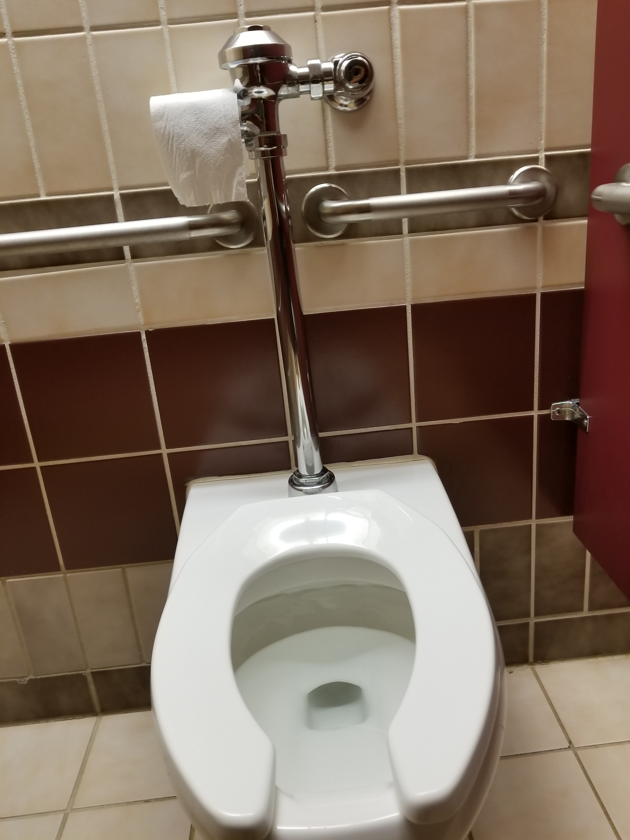
Notes:
Yes it is the well known hanging TP patch. Unfortunately, this is what happens when good intentioned sysadmins still trying to get into that DevSecOps way of thinking figure out how to get that thing working again and then can close the ticket! And then this is the solution that everyone lives with for a long period of time. And communication and collaboration are not good, particularly in such matters, so the implementation is sporadic and a lot of end users just learn to accept the shortcoming in the system.
So the takeaway is establish the devsecops practices from the start of the project and change the culture with the technology so that a path of continuous improvement can be realized.

Slide 54



It is hard to do immutable to the point of replace instead of patch
Lessons Learned, Comments, Advice
Sequencing of provisioning a big stack of related tools can be challenging – solved with smaller states and plan -target
Terraform is not as “DRY”, as many of us DevSecOps agents with developer backgrounds would prefer
Try to understand the “Hashi way” before really complaining about a perceived deficiency. Some things that allow for the power and flexibility are at the cost of other lesser causes
Notes:
1 - Instance data loss is one concern - including getting clients to think that way. More containers will help.
4 - Like when you understand why Plan is so important you can realize while more dynamic code and variables are problematic

Slide 55

Contact Me
Mike Augustine
mike.augustine825@gmail.com
@MAugustine825
Notes:
That’s it. Thanks for being here. Contact me if you have questions.

